Slide 1
EMAAR RECOMMENDATION ENGINE
Presented by:
Thirupathi Jadi, MBA-IT, B.Tech
Lead Data Scientist, India

Slide 2
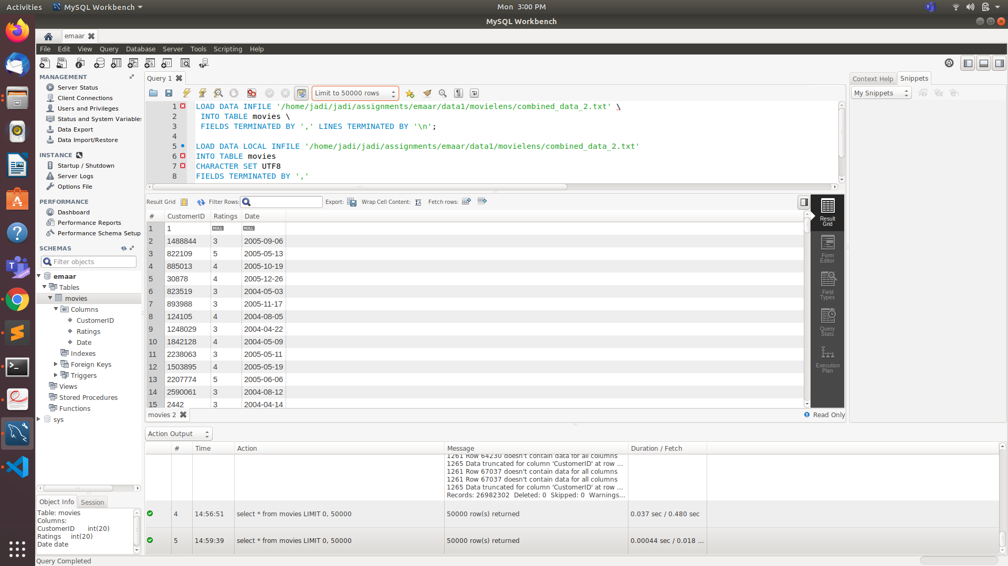
Task 1: Create Database
Solution:
Installed MySql database
Created Emaar database
Created Movies data table
Created 3 columns: 1. CustomerID, 2.Ratings, 3. Date
Stored the data into tables
Figure1: MySql Database

Slide 3
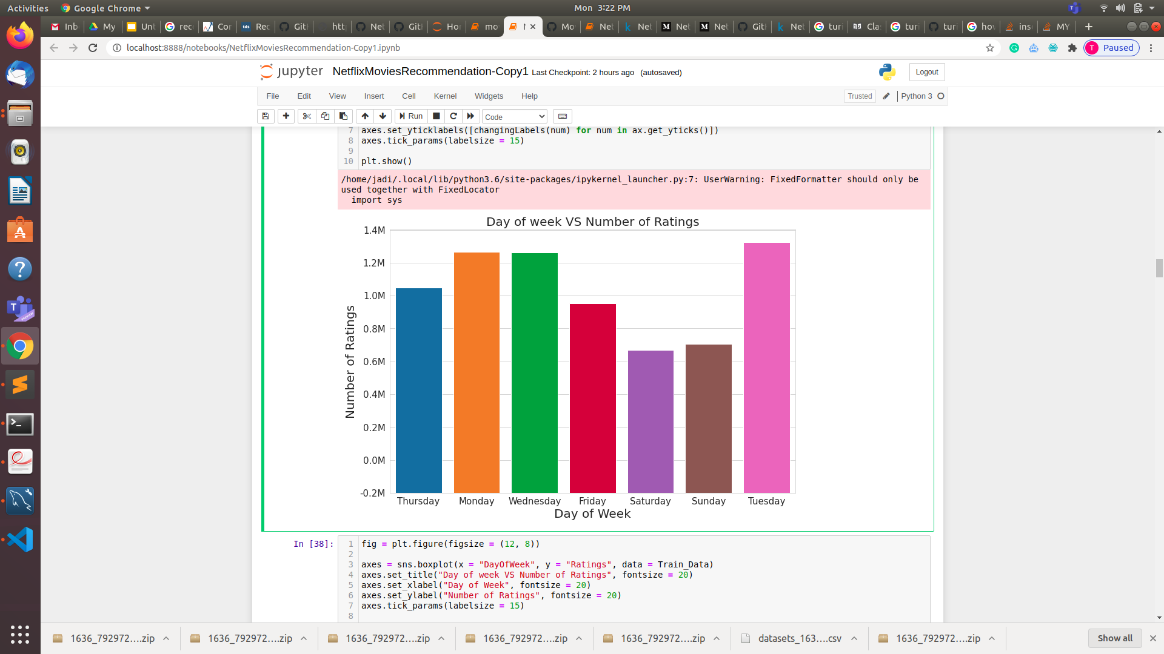
Task 2: Fetch data from database and perform analysis on top of the data and understand if there are any relationships between variables
Solution:
EDA on train data
Distribution of Ratings in train data
Number of Ratings per month
Day of week VS Number of Ratings
Figure 2: EDA Analysis

Slide 4
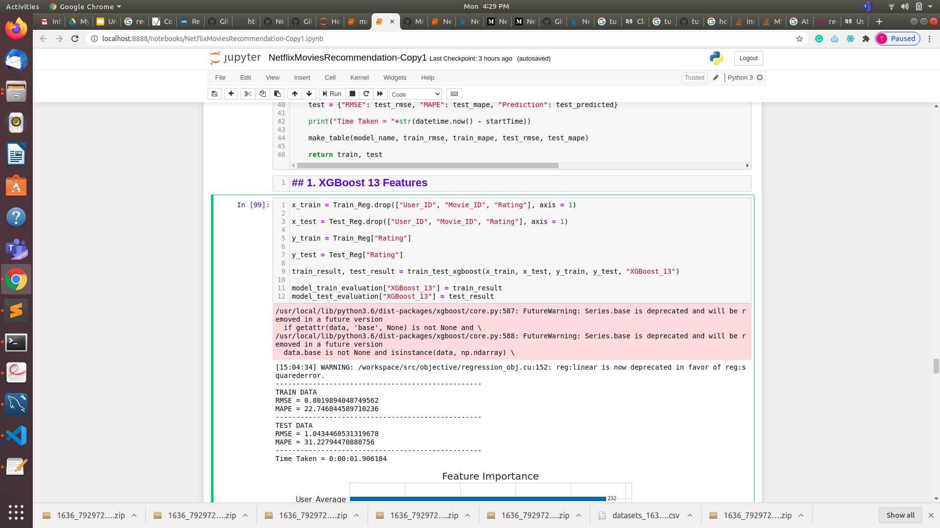
Task 3: Machine learning model to recommend movies
Solution:
XGBoost Machine learning model
Evaluation metric: RMSE
Figure 3: XGBoost machine learning model

Slide 5
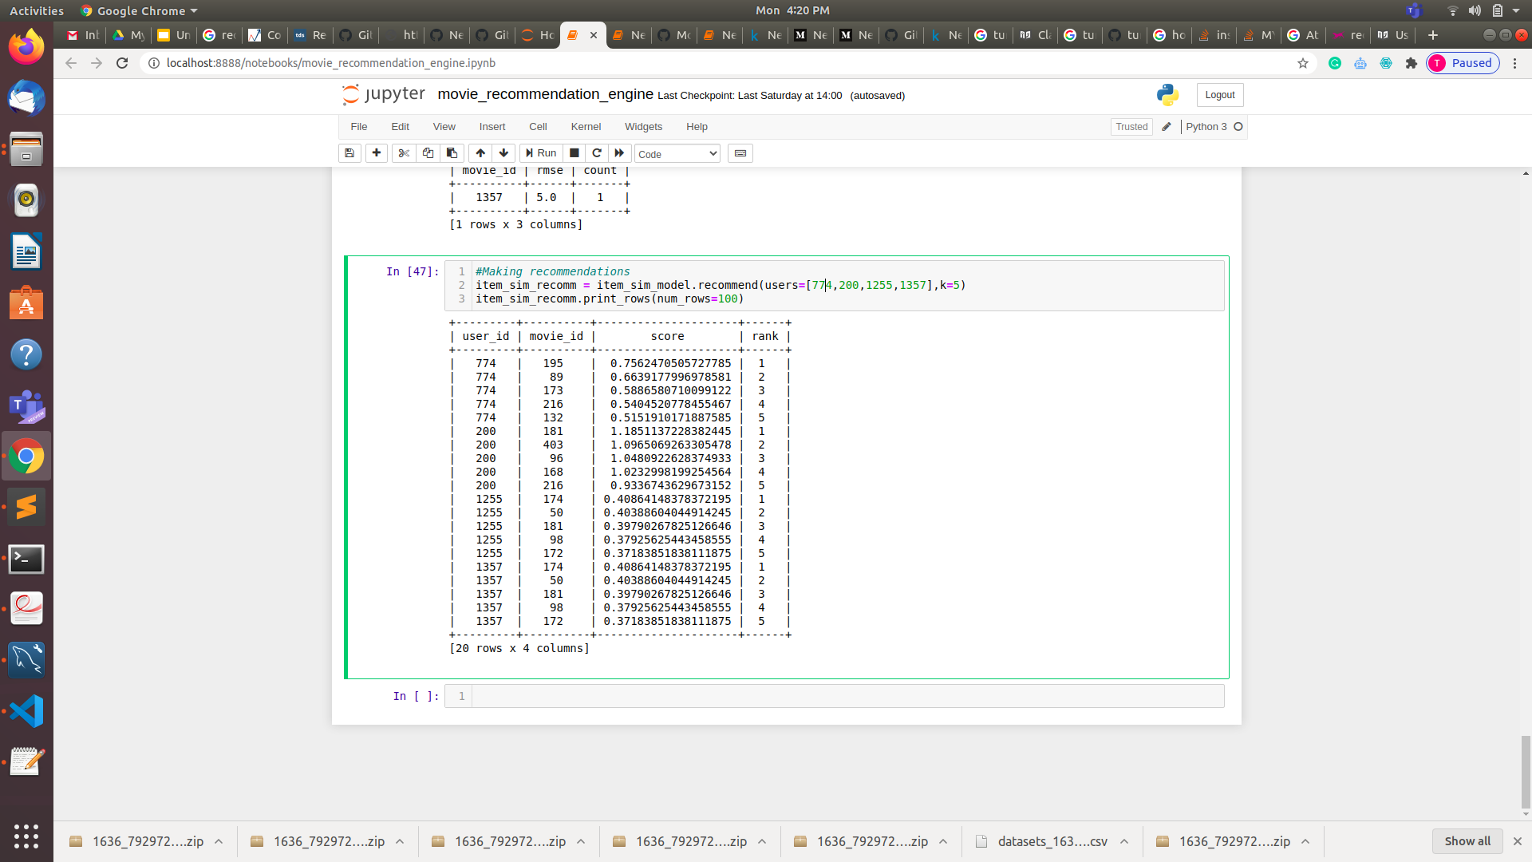
Task 3.1: Machine learning model to recommend movies
Solution:
Turi Create Model
Recommendations based on: user_id, movie_id,score,rank
Evaluation metric: RMSE
Figure 4: Turi Create model

Slide 6
Task 4: Store up to 5 recommendations
Figure 5: Results

Slide 7
Task 5: Technology Stock
Programming language: Python
Machine learning algorithms: XGBoost, Turi Create
Evaluation metric: RMSE
Database: MySql database
Visualization: Matplotlib, Seaborn, Pandas, Numpy

Slide 8
Thank You
Thirupathi Jadi, MBA-IT, B.Tech
Lead Data Scientist, India

